Slide 1
Who We Are
Zion Episcopal Church and St John’s Chapel are both located in Manchester, Vermont. The Rev. David Fredrickson is our new Priest in Charge for this dual ministry. Since 1782 residents in the Manchester area have worshiped at Zion Episcopal Church. As Manchester became a popular summer destination, the Diocese of Vermont established a Mission Church, St John’s Chapel. The doors of this beautiful Chapel first opened in 1867 welcoming permanent as well as summer residents. Both are vibrant mission-based churches dedicated to worship, service and spiritual growth.
The Manchester/Dorset area presents an abundance of opportunity to experience the outdoors, the arts, excellent schools and the appeal of two authentic New England villages. As such, the Priest and the members of both congregations often find one another sharing these experiences and activities.
To Know Christ’s Love and to Share it.

Slide 2
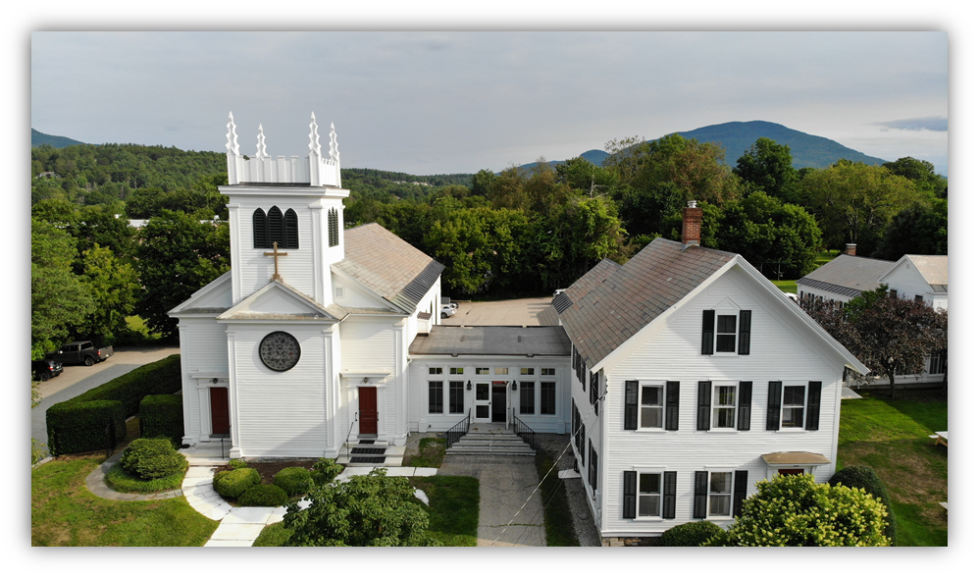
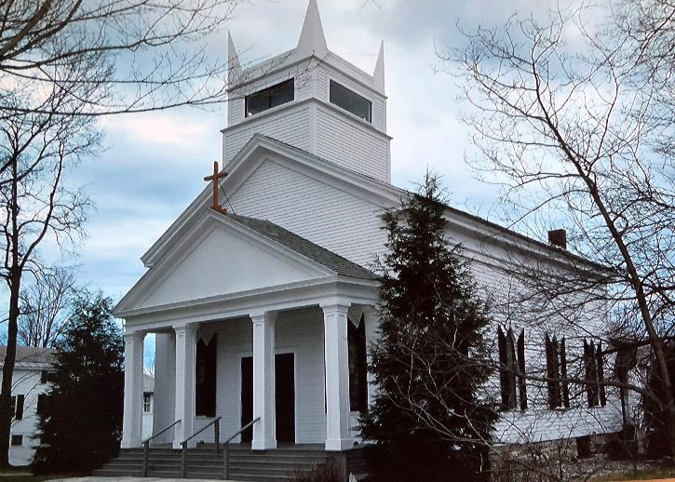
Zion Church
St. John’s Chapel
Our Mission
To Know Christ’s Love and to Share it.
Our Vision
Zion Episcopal Church is a vibrant community deeply rooted in prayer, spiritual growth and service.
Our Values
Christ Centered - Compassionate - Joyful - Intentional
“A word about our mission “To know Christ’s love and to share it.” Sounds simple, right? Yes, because the author of the perfect plan for us is Christ Himself. We just need to stay close and listen; for He will continue to place upon our hearts everything there is to know – and do – together.” Jamie Hastings, Senior Warden
To Know Christ’s Love and to Share it.

Slide 3
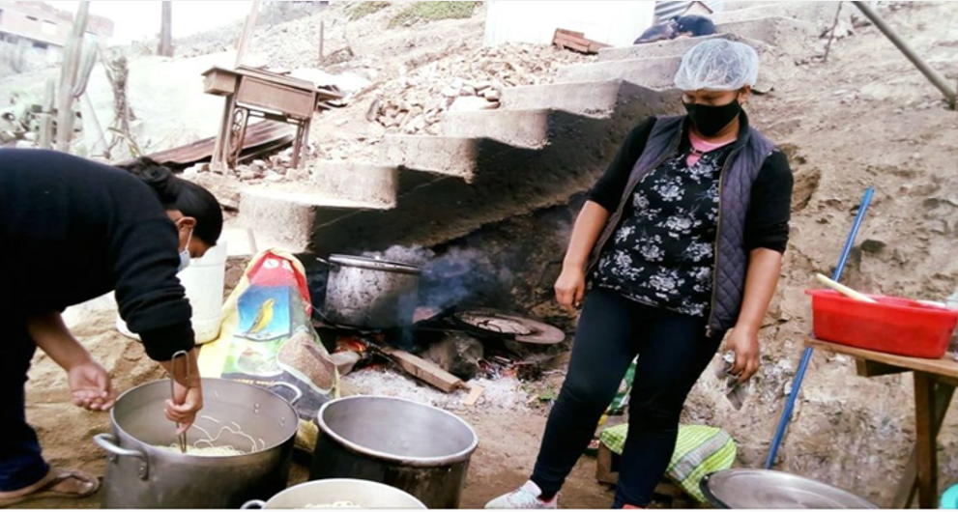
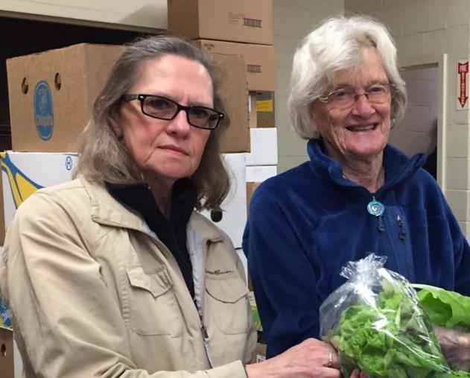
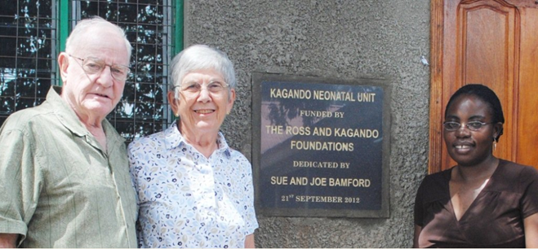
But do not forget to do good and to share, for with such sacrifices God is well pleased. Hebrews 13:16
Mission to Ministries
A mission- based church, Zion, strives to make our mission manifest and vibrant. National and International Outreach trough The Community Food Cupboard and the Peruvian Feeding Ministry, and the Kagando Mission in Uganda are examples of our commitment to our local community and to others far beyond us.
To Know Christ’s Love and to Share it.

Slide 4
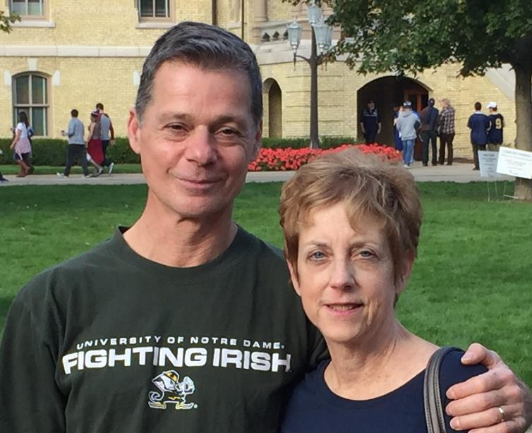
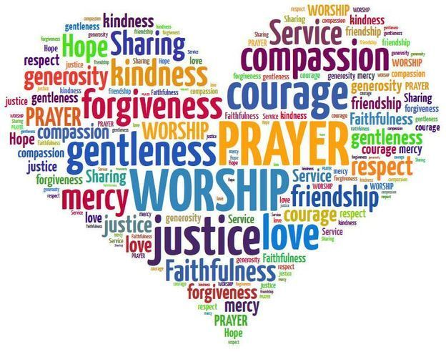
Who comforts us in all our affliction, so that we may be able to comfort those who are in any affliction, with the comfort with which we ourselves are comforted by God. 2 Corinthians 1:4
PASTORAL CARE MINISTRIES
Stephen Ministries, the Prayer Team and Pastoral Care Team offer opportunities for lay and clergy to share in and live our Mission while providing support and comfort. The Alpha Course affords lively conversation- to members and non-members of Zion - about the basics of the Christian faith whether a new or lifelong inquirer.
To Know Christ’s Love and to Share it.

Slide 5
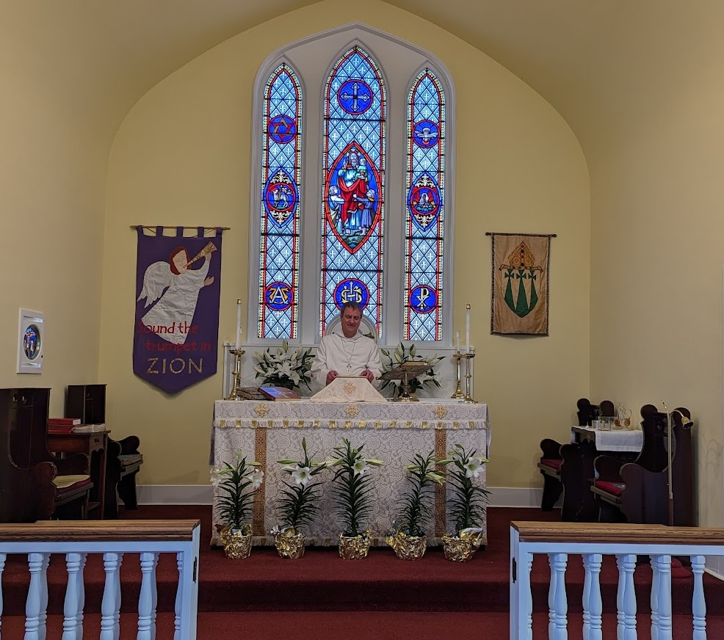
WORSHIP
Ascribe to the Lord the glory due his name; worship the Lord in the splendor of holiness. Psalm 29:2
The Book of Common Prayer and The 1982 Hymnal are our liturgical and musical texts. Worship at both Zion and St. John’s is Low Church. Both Rite I and Rite II are celebrated weekly. Lay involvement is essential to a vibrant church. At Zion and St John’s Chapel everyone is invited to become a Eucharistic Minister, Lector, Acolyte, Altar Guild Member, Choir Member or Usher. Participation in the Stewardship Committee offers another way to be involved. Christian Formation for both adults and children relies upon lay volunteers to make this another vital way to serve.
To Know Christ’s Love and to Share it.

Slide 6
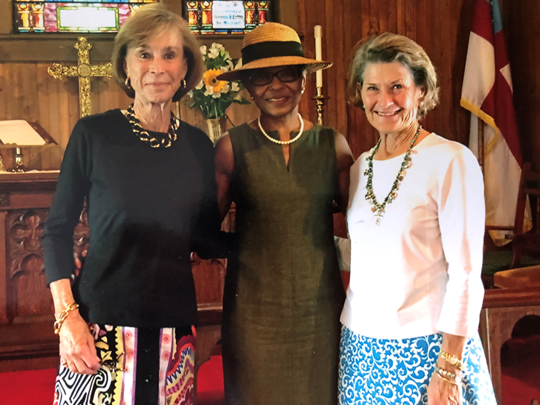
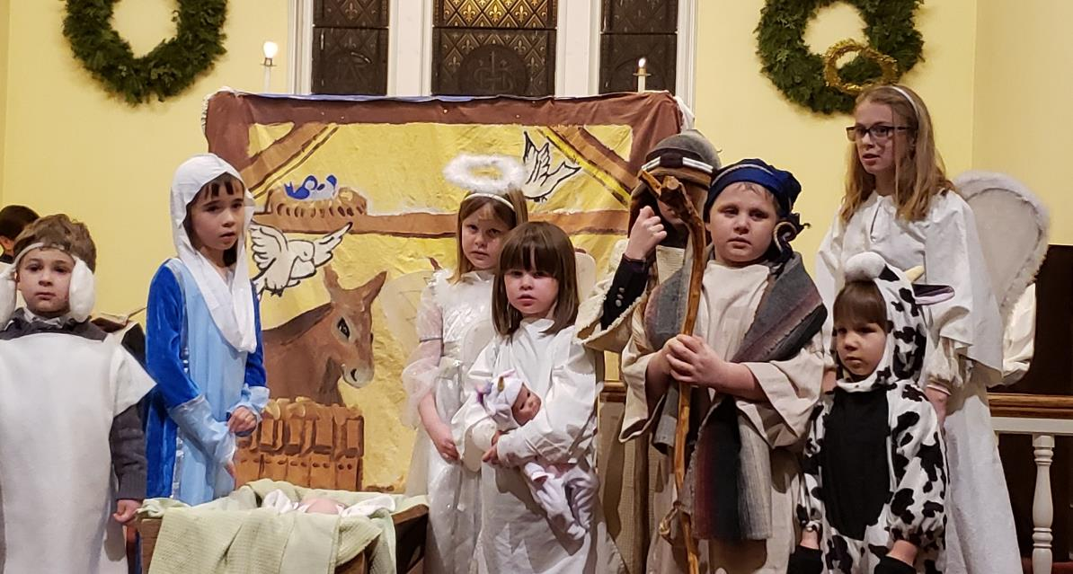
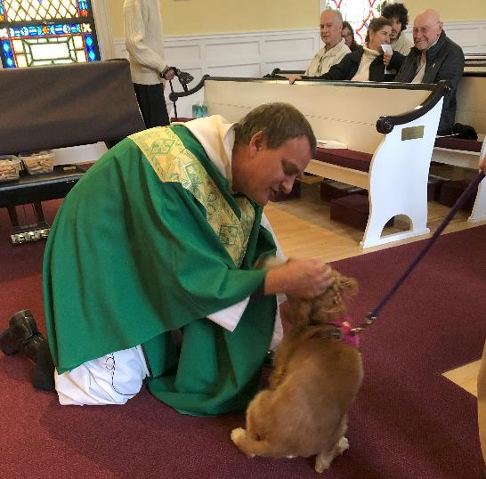
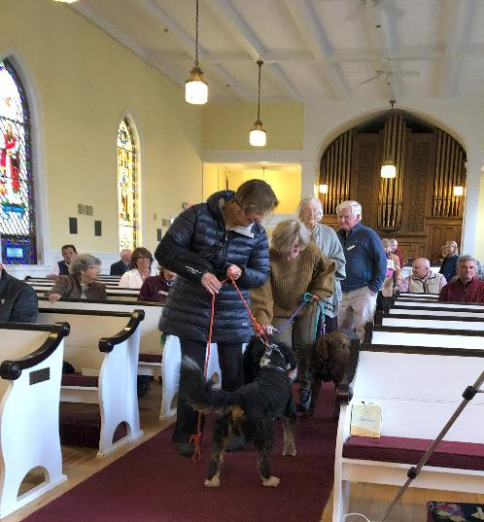
Let the little children come to Me, and do not forbid them; for of such is the kingdom of heaven. Luke: 18-16
Other Ministries
The future of the Episcopal Church lives within the hearts and minds of our children. The array of secular distractions present in their lives means programs for children and youth must be current and engaging as well as spiritually relevant. Traditions such as the Christmas Pageant, Easter Services, the Blessing of the Animals and joyful play have taken on new forms of expression grounded in the past.
To Know Christ’s Love and to Share it.

Slide 7
Liturgical Traditions
Zion and St John’s Chapel have a rich tradition of celebrating important days during the liturgical year. At Easter and Christmas we pray, sing and celebrate in our usual locations as well as a few additional iconic places. The Easter Sunrise Service has been held at Equinox Golf Course, Stratton Mountain, Bromley Mountain and Equinox Mountain and affords the opportunity to praise the Risen Lord in the majesty of the surrounding mountains. On Christmas Eve, St John’s Summer Chapel is opened and is beautifully decorated for a glorious celebration honoring the birth of Christ.
For where two or three are gathered together in My name, I am there in the midst of them. Matthew 18:20
To Know Christ’s Love and to Share it.

